Slide 1

Online Examination Portal
M Rithanya, VJ Vasudharini, Pranesh Priyadharshan S

Slide 2
Introduction
Most schools, colleges, universities, and even Government and Private offices have switched from traditional paper-based examinations to online examinations. Due to the wide-spread applications, this project might help you learn more about a wide variety of skills.

Slide 3
Outline of the project
The project should be capable of doing the following
....Loading

Slide 4
Features
01
02
03
04
User Authentication
Examination creation
User login, Updating profile and passwords
Choosing questions from a question-bank
Attempting Exam
Automatic Scoring
Allowing students to take exam.
The system should score automatically and display it.

Slide 5
Flowchart
Basic representation of the idea

Slide 6
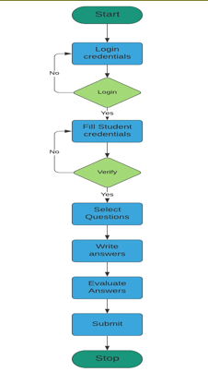
A flowchart helps in easy understanding of the code’s workflow.

Slide 7

Overview Of The Code:
1.The program starts by welcoming the user and attempting to authenticate them by asking for a username and password.
2. If the user provides the correct credentials, they are granted access to the exam.
3. The `generateQuestions` method creates a list of Java-related questions with answer choices and correct options.
4. The `conductExam` method presents these questions one by one to the user, collects their answers, and calculates the user's score.
5. After all questions have been answered, the program displays the user's score.

Slide 8
Code
Breakdown
Every class and method explained

Slide 9
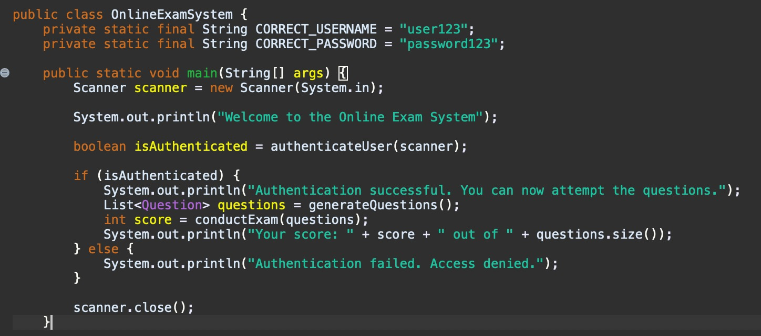
Class: OnlineExamSystem
This is the main class of the program that serves as an entry point. It handles user authentication, question generation, and exam conduction.
Methods in this class:
main Method
authenticateUser Method
generateQuestions Method
conductExam Method
createQuestion method

Slide 10
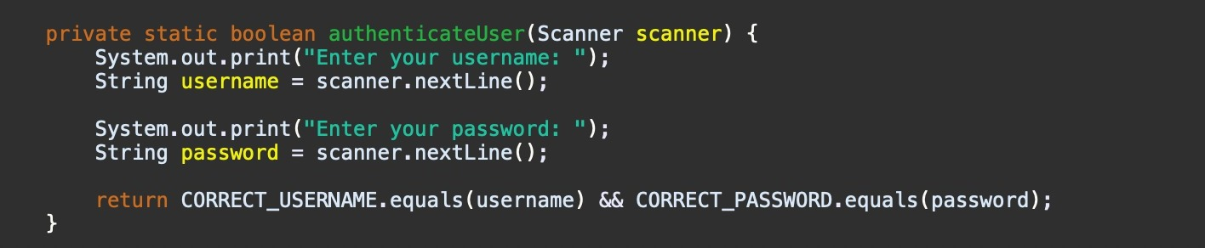
Method:authenticateUser
- This method is responsible for authenticating the user by checking their username and password.
- It takes user input for the username and password, compares them with predefined correct values, and returns a boolean value indicating whether authentication was successful.

Slide 11
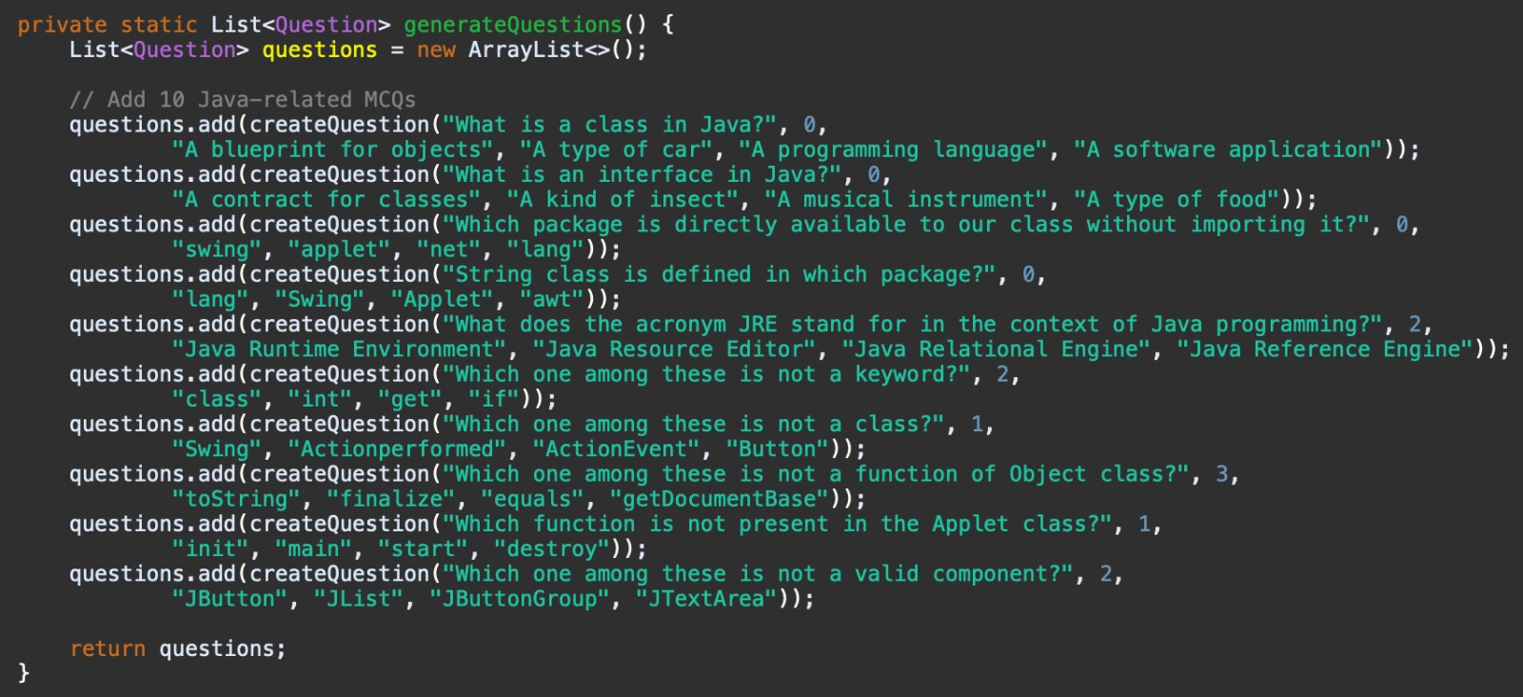
Method:generateQuestion
- This method is used to create a list of questions for the exam. In this code, it generates Java-related multiple-choice questions (MCQs).
- Each question is represented as a `Question` object and added to the list.
- The questions are created with options and the correct option index.

Slide 12
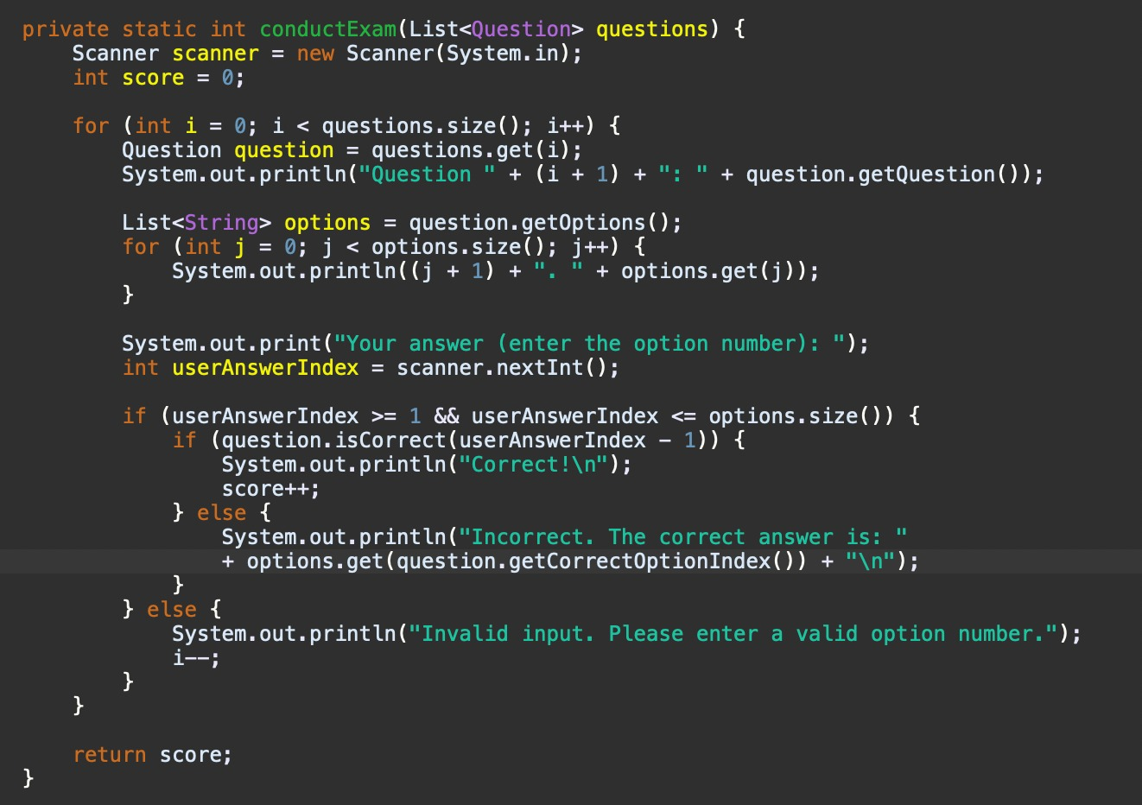
Method:conductExam
- This method handles the exam process, where the user is presented with questions and is expected to select an answer.
- It uses a `for` loop to iterate through the list of questions and presents each question to the user.
- The user's answer is collected, evaluated for correctness, and the score is updated accordingly.
- At the end of the exam, the user's score is returned.

Slide 13
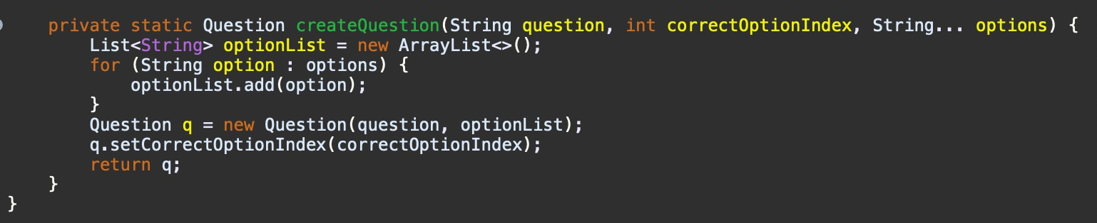
Method:createQuestion
-This method is used to create a multiple-choice question.It takes the question text, the index of the correct answer, and a variable number of options.
- It converts the options into a list and sets the correct option index for the question.
- Finally, it returns the created Question object.

Slide 14
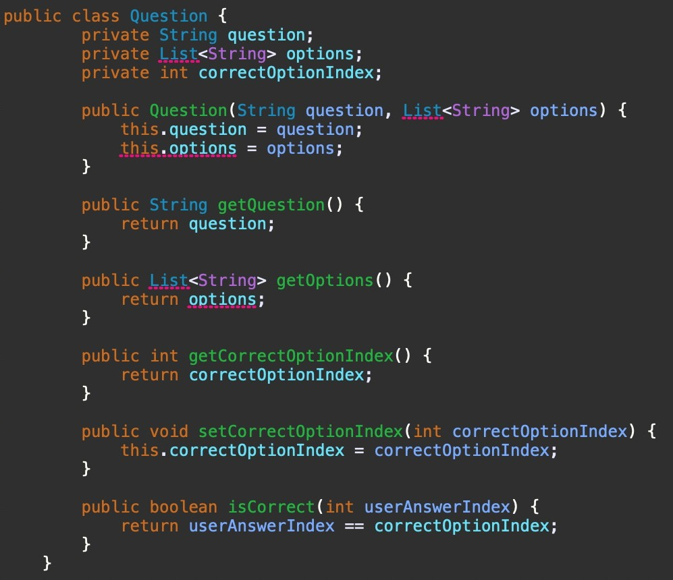
Class:Question
The `Question` class represents an individual question in the exam.
Methods in this class: - `isCorrect(int userAnswerIndex)`: This method checks if the user's answer (given by the index of the selected option) is correct by comparing it to the `correctOptionIndex`.
- `getQuestion()`: Returns the text of the question.
- `getOptions()`: Returns the list of answer choices.
- `getCorrectOptionIndex()`: Returns the index of the correct answer.

Slide 15
Thanks!

